Slide 1
Awt- Abstract Window Toolkit
Platform dependent API for creating Graphical User Interface (GUI) for java programs.
It was developed by Sun Microsystems In 1995.
Heavy-weight and platform dependent: AWT components are considered heavy weight because they are being generated by underlying operating system (OS). Components such as textbox, checkbox, button and others would have a different look and feel across platforms like windows, Mac OS & Unix, this is because these platforms have different look and feel for their native components and AWT directly calls their native subroutine that creates the component.
It is a part of Java Foundation Classes(JFC).

Slide 2
Swing
Swing is a lightweight independent API for creating Graphical User Interface (GUI) for java programs.
It was developed in 1997 by Sun Microsystems and Netscape Communications Corporation.
Swing components are independent of native Operating System's API as Swing API controls are rendered mostly using pure JAVA code instead of underlying operating system calls.
It is a part of Java Foundation Classes(JFC).

Slide 3
Awt
Swing
Heavy-weight and platform dependent.
Java AWT has comparatively less functionality as compared to Swing.
The execution time of AWT is more than Swing.
MVC pattern is not supported by AWT.
Light-weight and platform independent
Java Swing has more functionality as compared to AWT.
The execution time of Swing is less than AWT.
MVC pattern is supported by Swing.

Slide 4
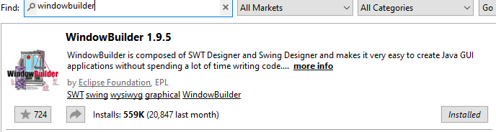
Install swing window builder
In the eclipse menu you can enter the marketplace through the Help tab. Search for windowbuilder and install the following:
After clicking install you will be asked which features to install, it’s recommended to install all the features.

Slide 5
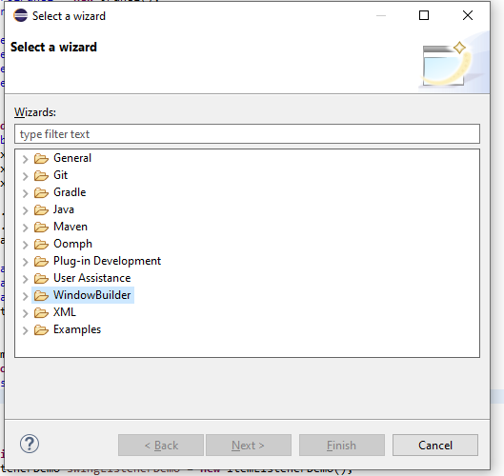

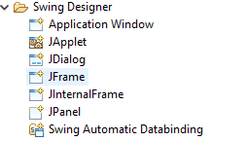
Swing window builder
Create new java project, in src folder Click on new and then other.
You will see the following window ➔
Inside WindowBuilder you will see the
following options:
Choose the Swing Designer and you
will see:

Slide 6
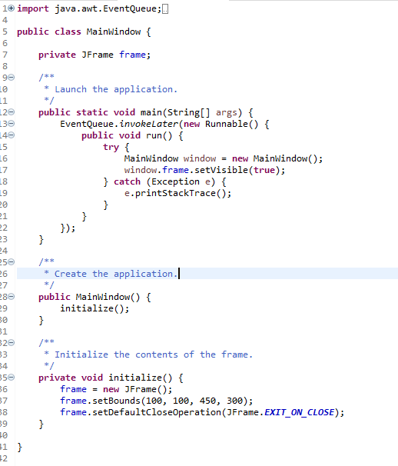
Swing window builder
Let’s create Application window.
This code will be generated automatically➔
It is called the source code
All it does is creating a simple JFrame and run it in a thread safe manner.

Slide 7

Swing window builder
Let’s switch to the designer mode
Below our code you will see this button:
Click on Design

Slide 8
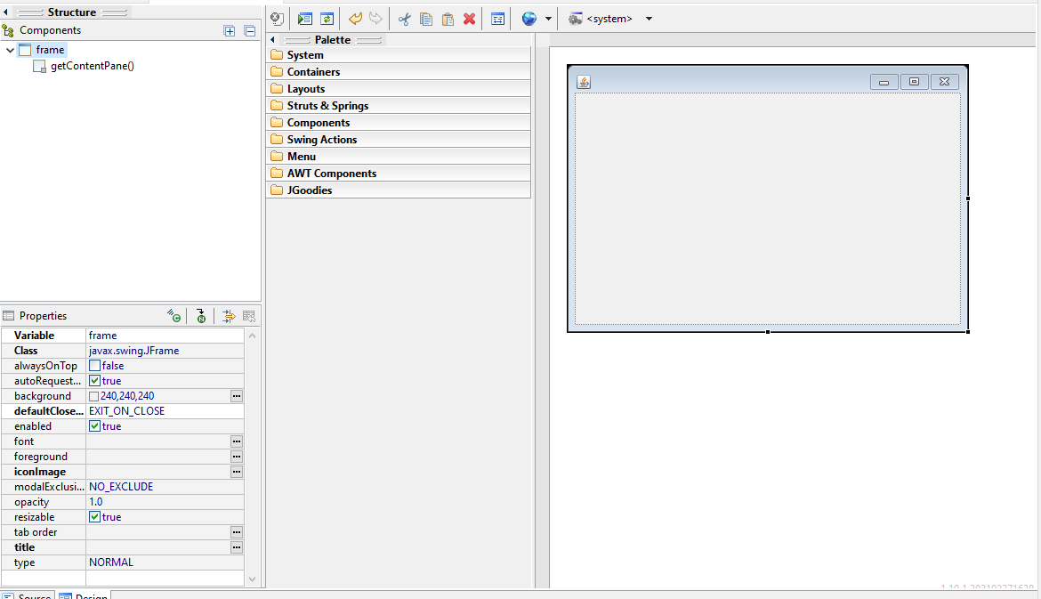
Swing window builder
App preview
Tree structure of the components inside the app
Different properties of specific component
Inside the palette we have different layout, components and actions that we can drop on the right screen and it will generate the code for us

Slide 9
Swing window builder
Preview without compilation
Reparse source code and refresh designer
Go to the definition in the source code
Show event of specific component
Show advanced properties

Slide 10
Swing Components
Java swing components are platform-independent and lightweight.
Java swing components are defined in javax.swing package.
Java swing components are built on top of awt components as we will see in the following class hierarchy.
Each swing component has different useful methods defined in it such as add, setSize, setVisible etc..

Slide 11
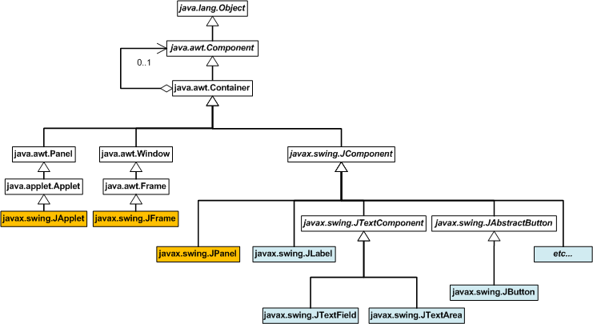
Class hierarchy
As we can see in this tree, all the swing component are built on top of awt container.
Jframe is built on top of awt frame which eventually also extends awt container.

Slide 12
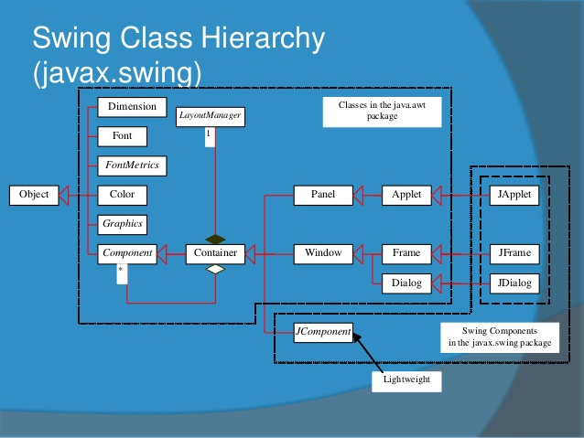
Class hierarchy
In the following tree we can see some more important class that we will use in our demos such as Font, Color, Graphics, Layout Manger etc..
All of those are classes in the java.awt package and we will be able to use them in our swing applications.

Slide 13
Swing Components- JFrame
The most basic swing component is Jframe
JFrame class is a type of container which inherits java.awt.Frame class. JFrame works like the main window where components like labels, buttons, textfields are added to create a GUI.
Constructors:
JFrame() – Default constructor
JFrame(GraphicsConfiguration gc) - Creates a frame with the specified GraphicsConfiguration of a screen device and a blank title.
JFrame(String title) – Creates a frame with the specified title.
JFrame(String title, GraphicsConfiguration gc) - Creates a frame with the specified title and the specified GraphicsConfiguration of a screen device.
Useful Method:
setSize(int width, int height) – Set the size of the frame (window).
setTitle(String title) – Set the title of the frame (window).
setIconImage(Image image) – Set the icon of the frame (window).
setVisible(bollean b) – True if the frame is visible.
setDefaultCloseOperation(int operation) – Set the operation that will happen when closing the application (Close/Hide/Do Nothing), we can use predefined values such as EXIT_ON_CLOSE, or use int values directly.
pack() - Set the window sizes to pack all the components within based on the component’s preferred size.
setLayout(LayoutManager manager) – Set the layout that will manages the different components locations.

Slide 14
Swing Components- JFrame
Best practice is to set visibility to true after adding all the components to the frame, sometimes there might be problems rendering if we will add the component after setting the visibility to true
We can create JFrame (and every other component) in two different ways:
By creating the object of Frame class (association)
By extending Frame class (inheritance)
Using association, first we will need to create JFrame instance, then we will use different methods to modify the component for our use.
Using inheritance, first we will create a class that extends JFrame, inside this class we will use different methods to modify the component for our use (we can even create other components inside this class and add them to the frame), then we will create new instance of our custom JFrame.
In our demos we will use both of the approaches but you need to keep in mind that the best practice in most of the cases is the association approach.
You can find good explanation on this: https://stackoverflow.com/questions/22003802/extends-jframe-vs-creating-it-inside-the-program

Slide 15
Swing Components- JLabel
JLabel is a GUI component that display one line of string, image or both.
JLabel extends JComponent class.
Constructors:
JLabel() – Default constructor, creates label with no image and with an empty string for the title.
JLabel(String s) - Creates a JLabel instance with the specified text.
JLabel(Icon i) - Creates a JLabel instance with the specified image.
JLabel(String s, Icon i, int horizontalAlignment) - Creates a JLabel instance with the specified text, image, and horizontal alignment.
Useful Methods:
setText(String text), getText() – Set and get the text of the label.
setFont(Font font) – Set the font of the label
setBackground(Color bg) – Set the background color of the label.
setHorizontalTextPosition(int textPosition), setVerticalTextPosition(int textPosition)- set the horizontal and vertical position, we can use predefined values such as CENTER, TOP etc..
setOpaque(bollean b) – If true paints every pixel within it’s bound. Useful in cases we want to use label without text but with background color that needs to be displayed.

Slide 16
Swing Components- JPanel
JPanel is a GUI component that function as a container that holds other components.
JPanel is good for code reuse.
JPanel extends JComponent class.
Constructors:
JPanel()- Default constructor, used to create a new JPanel with a double buffer and a flow layout.
JPanel(boolean isDoubleBuffered)- Used to create a new JPanel with FlowLayout and the specified buffering strategy.
JPanel(LayoutManager layout) - Used to create a new JPanel with the specified layout manager..
Useful Methods:
setLayout(LayoutManager manager)- Set the layout of the panel
setBackground(Color bg)- Set the background color of the panel.
add(Component c)- Add component to the panel.

Slide 17
Swing Components- JTextField
JTextField is a text component that allows the editing of a single line text.
JTextField extends JTextComponent which extends JComponent.
Constructors:
JTextField() – Default constructor, creates an empty TextField.
JTextField(String text) - Creates a new TextField initialized with the specified text.
JTextField(int columns)- Creates a new empty TextField with the specified number of columns.
JTextField(String text, int columns) - Creates a new TextField initialized with the specified text and number of columns.
Useful Methods:
setText(String text) - Set and get the text in the TextField.
addActionListener(ActionListener l), removeActionListener(ActionListener l)- Add and remove ActionListener to the TextField.
setEditable(boolean b) – Set if the TextField would be editable, even if not, it’s still selectable and the user can copy data from it.
setEnabled(boolean b) - Set if the TextField would be enabled, if not, the TextField would not be selectable and the user won’t be able to copy data from it.

Slide 18
Swing Components- JPasswordField
JPasswordField is a text component specialized for password entry.
JPasswordField allows the editing of a single line of text.
JPasswordField extends JTextField.
Constructors:
JPasswordField() – Default constructor, creates new JPasswordField, with a default document, null starting text string, and 0 column width.
JPasswordField(int columns)- Create new empty JPasswordField with the specified number of columns..
JPasswordField(String text)- Creates new JPasswordField initialized with the specified text.
JPasswordField(String text, int columns)- new JPasswordField initialized with the specified text and number of columns.
Useful Methods:
setEchoChar(char c)- Set the char that will replace every character like ‘*’.
getPassword()- Get the password as array of char.

Slide 19
Swing Components- JTextArea
JTextArea is a multi line region that displays text. It allows the editing of multiple line text.
JTextArea extends JTextComponent which extends JComponent.
Constructors:
JTextArea() – Default constructor, creates text area that displays no text initially.
JTextArea(String text) - Creates a new TextArea initialized with the specified text.
JTextArea(int row, int column)- Creates a new empty TextArea with the specified number of rows and columns with no displayed text.
JTextArea(String s, int row, int column) - Creates a new TextArea initialized with the specified text and number of rows and columns.
Useful Methods:
setRows(int rows), setCols(int cols), getRows(), getCols()- Set and get the rows and columns of the TextArea.
insert(String s, int position) - Used to insert the specified text at the specified position.
append(String s)- Used to append the given text to the end of the document.

Slide 20
Swing Components- JSpinner
JSpinner is a single line of input field that allows the user to select a number or an object value from an ordered sequence like date or list.
JSpinner extends JComponent.
Constructors:
JSpinner() – Default constructor, creates a spinner with an Integer SpinnerNumberModel with initial value 0 and no minimum or maximum limits.
JTextField(String text) - Creates a spinner for a given model.
Useful Methods:
addChangeListener(ChangeListener listener) - Used to add a listener to the list that is notified each time a change to the model occurs.
getValue()- Used to return the current value of the model.

Slide 21
Swing Components- JButton
JButton component is a labeled button that has platform independent implementation. The application result in some action when the button is pushed.
JButton extends AbstractButton class which extends Jcomponent.
Constructors:
JButton()- Default constructor. Creates button with no text and icon.
JButton(String s)- Creates a button with the specified text.
JButton(Icon i)- Creates a button with the specified icon object.
Useful Methods:
setText(String s), getText(), setIcon(Icon b), getIcon()- Set and get text and image of the button.
addActionListener()- Used to add ActionListener to button that will listen to the clicks.
setEnabled(boolean b)- Used to enable or disable the button.
setFocusable(boolean b)- Used to set or remove focus from the button.

Slide 22
Swing Components- JCheckBox
JCheckBox is used to create a checkbox that turns an option on (true) or off (false). Clicking on a CheckBox changes its state from "on" to "off" or from "off" to "on ".
JCheckBox extends JToggleButton class which extends AbstractButton.
Constructors:
JCheckBox()- Default constructor, Creates an initially unselected check box button with no text, no icon.
JCheckBox(String s)- Creates an initially unselected check box with text.
JCheckBox(String text, boolean selected)- Creates a check box with text and specifies whether or not it is initially selected.
JCheckBox(Action a)- Creates a check box where properties are taken from the Action supplied.
Useful Methods:
isSelected()- Get bollean depending on if the check box is selected.
setSelected()- Set if the check box is selected or not.

Slide 23
Swing Components- JComboBox
JComboBox is a component that combines a button or editable field and a drop down box. JComboBox can hold items.
JComboBox extends JComponent .
Constructors:
JComboBox()- Creates a JComboBox with a default data model.
JComboBox(Object[] items)- Creates a JComboBox that contains the elements in the specified array.
JComboBox(Vector<?> items)- Creates a JComboBox that contains the elements in the specified vector.
Useful Methods:
addItem(Object obj), removeItem(Object obj)- Add and remove item
removeAllItems()- Remove all items.
setSelectedItem(Object obj), setSelectedIndex(int index), getSelectedItem(), getSelectedIndex()

Slide 24
Swing Components- JTable
JTable is used to display data in tabular form. It is composed of rows and columns.
JTable extends JComponent .
Constructors:
JTable()- Default constructor, creates a table with empty cells.
JTable(Object[][] rows, Object[] columns)- Creates a table with the specified data.
Useful Methods:
setCellSelectionEnabled()- enable cells selection.
getSelectionModel()- Get the ListSelectionModel
getSelectedRows(), getSelectedColumns()- Get all the selected rows and columns

Slide 25
Swing Components- JList
JTable is used to display data in tabular form. It is composed of rows and columns.
JTable extends JComponent .
Constructors:
JList()- Default constructor, creates a JList with an empty, read-only, model.
JList(ary[] listData)- Creates a JList that displays the elements in the specified array.
JList(ListModel<ary> dataModel)- Creates a JList that displays elements from the specified, non-null, model.
Useful Methods:
addListSelectionListener(ListSelectionListener listener) - add a listener to the list, to be notified each time a change to the selection occurs..
getSelectedIndex(), getSelectedIndices() - Get the smallest selected index or array of all the selected indices in increasing order.
getSelectedValue(), getSelectedValuesList()- Get the selected item with smallest index, or all the selected items by their index in increasing order.
getModel()- Return the data model that holds a list of items displayed by the JList component.

Slide 26
Swing Components- JTabbedPane
JTabbedPane class is used to switch between a group of components by clicking on a tab with a given title or icon.
JTabbedPane extends JComponent.
Constructors:
JTabbedPane()- Default constructor, creates an empty TabbedPane with a default tab placement of JTabbedPane.Top.
JTabbedPane(int tabPlacement)- Creates an empty TabbedPane with a specified tab placement.
JTabbedPane(int tabPlacement, int tabLayoutPolicy)- Creates an empty TabbedPane with a specified tab placement and tab layout policy.
Useful Methods:
addTab(String text, Icon icon, Component c)- Add new tab to the TabbedPane.
setMnemonicAt(int index, int mnemonic)- Set shortcut keyboard key to panel at specific index.
setBackgroundAt(int, Color)- Set background color to panel at specific index.

Slide 27
Swing Components- JOptionPane
JOptionPane is pop up dialog box that informs users of something or prompts for a value, while the JOptionPane is open the user can't interact with the main window
JOptionPane provides standard dialog boxes such as message dialog box, confirm dialog box and input dialog box.
JOptionPane extends JComponent.
Constructors:
JOptionPane()- Default constructor.
JOptionPane(Object message) - Creates JOptionPane with message text.
JOptionPane(Object message, int messageType) - Creates JOptionPane with specified message type and the message text.
Useful Methods:
showMessageDialog(Component parentComponent, Object message)- Create an information-message dialog titled "Message".
showMessageDialog(Component parentComponent, Object message, String title, int messageType)- Create a message dialog with given title and messageType.
showConfirmDialog(Component parentComponent, Object message, String title, int optionType)- Create a confirm dialog with given title and optionType.

Slide 28
Swing Components- JDialog
JDialog control represents a top level window with a border and a title used to take some form of input from the user. It inherits the Dialog class.
JDialog extends Dialog.
Constructors:
JDialog()- Default constructor, create a modeless dialog without a title and without a specified Frame owner..
JDialog(Frame owner) - Create a modeless dialog with specified Frame as its owner and an empty title.
JDialog(Frame owner, String title, boolean modal) - Create a dialog with the specified title, owner Frame and modality.
JDialog vs JOptionPane- Differences:
JDialog can be more customized to our purposes, we can add to it different components while JOptionPane have limited predefined options.
JOptionPane is blocking the main window while JDialog not necessarily blocking the main window.

Slide 29
Swing Components- JMenuBar, JMenu and JMenuItem
JMenuBar is used to display menubar on the window or frame. It may have several menus.
JMenu is a pull down menu component which is displayed from the menu bar. It extends JMenuItem.
JMenuItem adds a simple labeled menu item.
The items used in a JMenuBar must belong to the JMenuItem or any of its subclass.
We will create a JMenuBar first, then we will add JMenuItem or JMenu (which extends JMenuItem) to it. To each JMenu we will be able to add more Jmenus or JMenuItems. This is a nice example of composite design pattern.
We can add shortcuts to the menu buttons using setMnemonic(int mnemonic) and the KeyEvents.

Slide 30
Swing Components- JPopupMenu
JPopupMenu can be dynamically popped up at specific position within a component.
JPopupMenu extends JComponent.
JPopupMenu can contain JMenus and JMenuItems.
Constructors:
JPopupMenu()- Default constructor, create a JPopupMenu without an "invoker".
JPopupMenu(String label)- Create a JPopupMenu with the specified title.
Useful Methods:
add(JMenuItem menuItem)- Add Jmenu or JMenuItem.
show(Component invoker, int x, int y)- Show the popup menu at certain location on the invoker.

Slide 31
Swing Components- JProgressBar
JProgressBar is used to display the progress of the task
JOptionPane extends JComponent.
Constructors:
JProgressBar()- Default constructor, Create a horizontal progress bar with no string text.
JProgressBar(int min, int max) - Create a horizontal progress bar with the specified minimum and maximum value.
JProgressBar(int orient) - Create a progress bar with the specified orientation, it can be either Vertical or Horizontal.
JProgressBar(int orient, int min, int max)- Create a progress bar with the specified orientation, minimum and maximum value.
Useful Methods:
setStringPainted(bollean b)- Set if to display string text on the progress bar.
setValue(int value)- Set the progress value.
setString(String s)- Set the progress string message.

Slide 32
Swing Components- JColorChooser
JColorChooser is used to create a color chooser dialog box so that user can select any color from it.
JColorChooser extends JComponent.
Constructors:
JColorChooser()- Default constructor, create a color chooser panel with white color initially.
JColorChooser(color initialcolor) - Create a color chooser panel with the specified color initially.
Useful Methods:
showDialog(Component c, String title, Color initialcolor)- static method that used to show the color chooser dialog box. This method will return the color that the user picked.

Slide 33
Swing Components- JFileChooser
JColorChooser is used to create a color chooser dialog box so that user can select any color from it.
JColorChooser extends JComponent.
Constructors:
JFileChooser()- Default constructor, create a JFileChooser pointing to the user's default directory.
JFileChooser(File currentDirectory)- Create a JFileChooser using the given File as the path.
JFileChooser(String currentDirectoryPath)- Create a JFileChooser using the given path.
Useful Methods:
showOpenDialog(Component parent)- Open the file dialog on top of the parent component.
getSelectedFile()- Get the selected file by the user in the dialog.
setCurrentDirectory(File dir)- Sets the current directory of the file chooser based on the path of provided file.

Slide 34
Swing Components- JSlider
JSlider is used to create slider with which a user can select value from a specific range.
JSlider extends JComponent.
Constructors:
JSlider()- Default constructor, slider with the initial value of 50 and range of 0 to 100.
JSlider(int orientation)- creates a slider with the specified orientation set by either JSlider.HORIZONTAL or JSlider.VERTICAL with the range 0 to 100 and initial value 50.
JSlider(int min, int max, int value)- Creates a horizontal slider using the given min, max and value.
JSlider(int orientation, int min, int max, int value) - Creates a slider using the given orientation, min, max and value.
Useful Methods:
setMinorTickSpacing(int n), setMajorTickSpacing(int n)- Set the minor and major tick spacing to the slider.
setPaintTicks(boolean b), setPaintLabels(boolean b), setPaintTracks(boolean b)- Used to determine whether ticks/ labels/ track is painted.
setValue(int value), getValue()- Set and get value of the slider.

Slide 35
Swing Components- JTree
JTree class is used to display the tree structured data or hierarchical data.
JTree is a complex component that has a 'root node' at the top which is a parent for all nodes in the tree.
JTree extends JComponent.
Constructors:
JTree()- Default constructor.
JTree(Object[] value)- Creates a JTree with every element of the specified array as the child of a new root node.
JTree(TreeNode root)- Creates a JTree with the specified TreeNode as its root, which displays the root node.
There are few Tree-Related Classes and Interfaces that help us to work with JTree such as: TreePath, TreeCellEditor, TreeSelectionModel etc..

Slide 36
Layout Managers
The Layout Managers are used to arrange components in a particular manner.
LayoutManager is an interface that is implemented by all the classes of layout managers.
There are total of 9 Layout Managers, 5 of them provided for us by awt and 4 more provided by Swing.
In order to use any Layout Manger, first we will need to set the layout of the container component using setLayout(LayoutManager manager) method.

Slide 37
Layout Managers- BorderLayout
The BorderLayout is used to arrange the components in five regions: north, south, east, west and center.
Each region (area) may contain one component only.
It is the default layout of frame or window.
Defined by awt.
Constructors:
BorderLayout()- creates a border layout with no gaps between the components.
BorderLayout(int hgap, int vgap): creates a border layout with the given horizontal and vertical gaps between the components.
How do we use it?
When we add a component to a frame or a panel with BorderLayout we need to provide second argument that is a constant defined inside the BorderLayout class. There are 5 constants provided with same names as the regions.

Slide 38
Layout Managers- GridLayout
The GridLayout place components in a grid of cells like a table.
Each component will fit into all the available space in the cell, all the cells are the same size
Defined by awt.
Constructors:
GridLayout()- Creates a grid layout with one column per component in a row.
GridLayout(int rows, int columns)- Creates a grid layout with the given rows and columns but no gaps between the components.
GridLayout(int rows, int columns, int hgap, int vgap)- Creates a grid layout with the given rows and columns along with given horizontal and vertical gaps.
How do we use it?
When we add a component to a frame or a panel with GridLayout, the component will fit into the first empty cell in the grid.
If we defined more cells than components, some of the cells would remain empty.
If we defined more components than cells, the grid will new columns till all the components are fit into cells.

Slide 39
Layout Managers- FlowLayout
FlowLayout is used to arrange the components in a line, one after another, sized in their preferred size.
If the horizontal space in the row is too small it will use the next available row
It is the default layout of applet or panel.
Defined by awt.
Constructors:
FlowLayout()- Creates a flow layout with centered alignment and a default 5 unit horizontal and vertical gap.
FlowLayout(int align)- Creates a flow layout with the given alignment and a default 5 unit horizontal and vertical gap.
FlowLayout(int align, int hgap, int vgap)- Creates a flow layout with the given alignment and the given horizontal and vertical gap.
How do we use it?
When we add a component to a frame or a panel with FlowLayout, the component be placed in a row along side with other components. If there is not enough space in this row, is will use the next available row.
We can specify the alignment of the layout in constructor using the provided constants inside FlowLayout class: LEFT, RIGHT, CENTER, LEADING, TRAILING.

Slide 40
Layout Managers- BoxLayout
The BoxLayout is used to arrange the components either vertically or horizontally.
Defined by Swing.
Constructors:
BoxLayout(Container c, int axis)- Creates a box layout that arranges the components with the given axis.
How do we use it?
When we add a component to a frame or a panel with BoxLayout, the component be placed in a vertical or horizontal order one ager another based on the axis provided.
We can specify the axis of the layout in constructor using the provided constants inside BoxLayout class: X_AXIS, Y_AXIS, LINE_AXIS, PAGE_AXIS.

Slide 41
Layout Managers- CardLayout
The CardLayout class manages the components in such a manner that only one component is visible at a time.
It treats each component as a card and have useful methods such as next(Container parent), previous(Container parent), first(Container parent), last(Container parent), show(Container parent, String name).
Defined by awt.
Constructors:
CardLayout()- creates a card layout with zero horizontal and vertical gap.
CardLayout(int hgap, int vgap): creates a card layout with the given horizontal and vertical gap.
How do we use it?
When we add a component to a frame or a panel with CardLayout, the component will be added to the “button” of the card stack.
We can add a name for each component while adding it to the container component by passing a String as the first parameter in add() method.
We can jump between the cards using the methods mentioned above.

Slide 42
Layout Managers- GridBagLayout
The GridBagLayout is used to align components vertically, horizontally or along their baseline.
You can think of it as a GridLayout with more capabilities.
The components may not be of same size. Each GridBagLayout object maintains a dynamic, rectangular grid of cells.
Each component occupies one or more cells known as it’s display area.
Defined by awt.
Constructors:
GridBagLayout()- Creates a grid bag layout.
How do we use it?
When we add a component to a frame or a panel with GridBagLayout, we will pass a GridBagConstraints instance with the desired constraints.
GridBagConstraints specifies different constraints that we can apply to the components such as: fill, gridx, gridy, ipadx, ipady, gridwidth etc..

Slide 43
Layout Managers- GroupLayout
GroupLayout groups its components and places them in a Container hierarchically. The grouping is done by instances of the Group class.
Group is an abstract class and two concrete classes which implement this Group class are SequentialGroup and ParallelGroup.
SequentialGroup positions its child sequentially one after another where as ParallelGroup aligns its child on top of each other.
GroupLayout treats each axis independently. That is, there is a group representing the horizontal axis, and a group representing the vertical axis. Each component must exists in both a horizontal and vertical group, otherwise an IllegalStateException is thrown during layout, or during the request of minimum, preferred or maximum size.
Defined by Swing.
Constructors:
GroupLayout(Container host)- Creates a GroupLayout for the specified Container.
How do we use it?
When we add a component to a frame or a panel with GroupLayout, we will need to add the component both to the vertical group and the horizontal group.
Inside each one of this groups we will create sequential or parallel group to which we will add some more sequential or parallel group that will hold one or more components.
This is a little difficult to understand, think of it as a table. First we will set the horizontal group, to this horizontal group we will add few parallel groups (like columns) in a sequence, then we will set the vertical group, and to the vertical group we will add few parallel groups (like rows) in a sequence.

Slide 44
Events
Change in the state of an object is known as event i.e. event describes the change in state of source.
Events are generated as result of user interaction with the graphical user interface components. For example, clicking on a button, moving the mouse, entering a character through keyboard, selecting an item from list, scrolling the page are the activities that causes an event to happen.
There are two types of events:
Foreground Events - require the direct interaction of a user. They are generated as consequences of a person interacting with the graphical components in Graphical User Interface. For example, clicking on a button, moving the mouse, entering a character through keyboard, selecting an item from list, scrolling the page etc.
Background Events - Those events that require the interaction of end user are known as background events. Operating system interrupts, hardware or software failure, timer expires, an operation completion are the example of background events.

Slide 45
Event Handling
Event Handling is the mechanism that controls the event and decides what should happen if an event occurs.
Java Uses the Delegation Event Model to handle the events. This model defines the standard mechanism to generate and handle the events.
The delegation event model contains:
Source - The source is an object on which event occurs. Source is responsible for providing information of the occurred event to it's handler.
Listener - It is also known as event handler. Listener is responsible for generating response to an event. From java implementation point of view the listener is also an object. Listener waits until it receives an event. Once the event is received , the listener process the event and then returns.

Slide 46
Event Handling
There are different ways to handle an event:
Most easy option is to register the event to instance of a class that implement ActionListener interface (can be any other listener interface).
Anonymous objects by creating instance of the ActionListener (can be any other listener interface) that will implement the methods defined in the interface.
Arrow function that will receive the event as an argument and do some action.

Slide 47
Awt Event Handling
Sometimes components might have more that one EventListener for example: JButton can have ActionListener, FocusListener, ChangeListener and a few more.
We can register to the component few event listeners of same type for example: Register two action listeners to the button and do different action in each.
We can register few components to the same event listener for example: Two buttons registered to the event listener, when clicking on one of the buttons the event is invoked and then we are checking the source using if-else or switch.

Slide 48
Awt Events
Awt events are predefined events provided us by awt that we can use in our awt and Swing applications.
AWTEvent is the root event class for all AWT events. This class and its subclasses supercede the original java.awt.Event class. This class is defined in java.awt package.
AWTEvent has a method named getID() that can be used to determine the type of event.
AWTEvent extends EventObject class, one of the most common methods that we will use getSource(), is a methods defined in the EventObject class.

Slide 49
Awt Events- Action Event
Awt events are predefined events provided us by awt that we can use in our awt and Swing applications.
AWTEvent is the root event class for all AWT events. This class and its subclasses supercede the original java.awt.Event class. This class is defined in java.awt package.
AWTEvent has a method named getID() that can be used to determine the type of event.

Slide 50
Event Listeners
Event Listeners are representing the interfaces responsible to handle events.
Every method of an event listener method has a single argument which is an object that is subclass of EventObject class. For example, mouse event listener methods will accept instance of MouseEvent, since MouseEvent derives from EventObject.
EventListener interface is a marker interface that every listener interface has to extend. This class is defined in java.util package.

Slide 51
ActionEvent & ActionListener
ActionEvent is invoked when action occurs on the view, for example: button has been clicked, selected item inside combo box or list has been changed etc..
ActionEvent has few useful methods defined such as:
int getModifiers()- returns the modifier keys held down during this action event.
long getWhen()- returns the timestamp of when this event occurred.
ActionListener is listener interface for receiving action events.
ActionListener has one method defined in it: void actionPerformed(ActionEvent e). This method invoked when action occurs.

Slide 52
KeyEvent & KeyListener
KeyEvent is invoked when pressing a key on a focused component.
KeyEvent can be one of the following: KEY_PRESSED, KEY_RELASED, KEY_TYPED.
Inside the KeyEvent are a lot of integer constants declared that each of them represents different button on the keyboard.
KeyEvent has few useful methods defined such as:
int getKeyChar ()- returns the character associated with the key in this event.
int getKeyCode()- returns the integer keyCode associated with the key in this event.
static String getKeyModifiersText(int modifiers)- Returns a String describing the modifier key(s), such as "Shift", or "Ctrl+Shift".
static String getKeyText(int keyCode)- Returns a String describing the keyCode, such as "HOME", "F1" or "A".
KeyListener is listener interface for receiving key events.
KeyListener has three methods defined in it:
void keyPressed(KeyEvent e)- invoked when a key has been pressed.
void keyReleased(KeyEvent e)- invoked when a key has been released.
void keyTyped(KeyEvent e)- invoked when a key has been typed.

Slide 53
MouseEvent & MouseListener
MouseEvent is invoked while a mouse action occurred in a component.
Mouse actions can be the following: click, drag, move, press, release , enter, exit, wheel.
MouseEvent has few useful methods defined such as:
int getButton()- returns which, if any, of the mouse buttons has changed state, using this method we are able to check which button on the mouse has been clicked.
int getClickCount()- Returns the number of mouse clicks associated with this event.
Point getLocationOnScreen()- Returns the absolute x, y position of the event.
MouseListener is listener interface for receiving mouse events.
MouseListener has five methods defined in it:
void mouseClicked(MouseEvent e)- invoked when the mouse button has been clicked (pressed and released) on a component.
void mouseEntered(MouseEvent e)- invoked when the mouse enters a component.
void mouseExited(MouseEvent e)- invoked when the mouse exits a component.
void mousePressed(MouseEvent e)- invoked when a mouse button has been pressed on a component.
void mouseReleased(MouseEvent e)- invoked when a mouse button has been released on a component.

Slide 54
MouseMotionEvent & MouseMotionListener
There is no class named MouseMotionEvent, MouseMotionListener actually listens to mouse events. We will just call it MouseMotionEvents for convenience.
MouseMotionEvent is invoked while a mouse moves on a component.
Mouse can be moved on the component while it’s not pressed, it can also be dragged while it’s pressed.
Since MouseMotionEvents are actually MouseEvents, we can use the MouseEvent defined methods.
MouseMotionListener is listener interface for receiving mouse motion events.
MouseMotionListener has two methods defined in it:
void mouseDragged(MouseEvent e)- invoked when a mouse button is pressed on a component and then dragged.
void mouseMoved(MouseEvent e)- invoked when the mouse cursor has been moved onto a component but no buttons have been pushed.

Slide 55
Awt Events and EventListeners
There are more Events and EventListeners that are defined by awt for our use, for example:
WindowEvent and WindowListener- Events that occur due to change in state of a window.
ItemEvent and ItemListener- Events that occur due to change in state of an item.
FocusEvent and FocusListener- Events that occur due to change in the focus.

Slide 56
Awt Event Adapters
Adapters are abstract classes that provide us default implementation of EventHandler interface. The methods in those adapters are empty.
Why do we need them? Think for example that you want to register MouseListener that 5 methods defined, but you need only one. This is the spot where adapters can be useful. Instead of implementing the interface, all we to do is to extend the adapter. Now all we need to do is just to override one method.
Not all EventHandlers have EventAdapters, only some of them have.
Examples for EventAdapters: MouseAdapter, MouseMotionAdapter, KeyAdapter, WindowAdapter, FocusAdapter.

Slide 57
Key Bindings
Using key bindings we cab bind an action to a key stroke.
We don't have to be focused on the component in order for it to react to the key stroke
All swing components can use key bindings.
It is more flexible than KeyListeners, you can assign key stroke to individual swing component.
It can save us the switch case on checking which key has been pressed. It can also help us reusing same actions for several components or several key strokes.
Only disadvantage is that is more difficult to utilize and set up.
How to do key binding?
Create an action that implements Action interface (we can instead extend the AbstractAction class which is an abstract class that provides default implementation of the Action interface).
Set the key stroke that will trigger the action and a custom name that we choose to serve as the key together to input map of the desired component.
Set the name key we defined in step 2 and an instance of the class we created in step 1 to the action map of the desired component.

Slide 58
MVC in Swing
The Model-View-Controller is a well known software architectural pattern ideal to implement user interfaces on computers by dividing an application into three interconnected parts.
Main goal of Model-View-Controller, also known as MVC, is to separate internal representations of an application from the ways information is presented to the user (separation of concerns).
The components of MVC are the following:
Model- manages data, logic and rules of the application
View- used to present data to user
Controller- accepts input from the user and converts it to commands for the Model or View.

Slide 59

MVC in Swing
The Model receives commands and data from the Controller. It stores the data and updates the View. The View presents the data provided by the Model to the user. The Controller accepts inputs from the user and converts it to commands for the Model or the View.

Slide 60
PropertyChangeEvent & PropertyChangeListener
Property-change events occur whenever the value of a bound property changes for a bean — a component that conforms to the JavaBeans™ specification.
A JavaBeans property is accessed through its get and set methods. For example, JComponent has the property font which is accessible through the getFont and setFont methods.
Besides the get and set methods, a bound property fires a property-change event when its value changes.
Some scenarios that commonly require property-change listeners include:
You have implemented a formatted text field and need a way to detect when the user has entered a new value. You can register a property-change listener on the formatted text field to listen to changes on the value property.
You have implemented a dialog and need to know when a user has clicked one of the dialog's buttons or changed a selection in the dialog.
You need to be notified when the component that has the focus changes. You can register a property-change listener on the keyboard focus manager to listen to changes to the focusOwner property.

Slide 61
Multithreading in Swing
Every program has a set of threads where the application logic begins. In standard programs, there's only one such thread: the thread that invokes the main method of the program class (also called initial thread).
In Swing programs, the initial threads don't have a lot to do. Their most essential job is to create a Runnable object that initializes the GUI and schedule that object for execution on the event dispatch thread.
Once the GUI is created, the program is primarily driven by GUI events, each of which causes the execution of a short task on the event dispatch thread. Application code can schedule additional tasks on the event dispatch thread (if they complete quickly, so as not to interfere with event processing) or a worker thread (for long-running tasks).
An initial thread schedules the GUI creation task by invoking javax.swing.SwingUtilities.invokeLater or javax.swing.SwingUtilities.invokeAndWait.
Both of these methods take a single argument: the Runnable that defines the new task.
Their only difference is indicated by their names: invokeLater simply schedules the task and returns (asynchronous task); invokeAndWait waits for the task to finish before returning (synchronous task).
Both invokeLater and invokeAndWait will execute their Runnable task after all other tasks on the event dispatch queue have been processed. In other words, these methods put the Runnable task at the end of the existing queue.
The event dispatch thread will run over the queue and execute each task one by one.
Using invokeAndWait from the event dispatch thread would create the same response delays that we are trying to avoid and that why we will always prefer using invokeLater from the event dispatch thread.

Slide 62
Awt EventQueue
EventQueue is a platform-independent class defined by awt that queues events, both from the underlying peer classes and from trusted application classes.
It encapsulates asynchronous event dispatch machinery which extracts events from the queue and dispatches them by calling dispatchEvent(AWTEvent) method on this EventQueue with the event to be dispatched as an argument.
EventQueue has also invokeLater and invokeAndWait methods that we can use. In fact, the SwingUtilities.invokeLater version is just a thin wrapper method that calls the EventQueue.invokeLater method. Because the Swing framework itself uses SwingUtilities frequently, your use of SwingUtilities does not pull any extra class code into your application.

Slide 63
Event dispatch thread
The event dispatch thread is a special thread that runs Swing event handling code. Most code that invokes Swing methods also runs on this thread.
This is necessary because most Swing object methods are not "thread safe": invoking them from multiple threads risks thread interference or memory consistency errors. Some Swing component methods are labelled "thread safe" in the API specification; these can be safely invoked from any thread. All other Swing component methods must be invoked from the event dispatch thread. Programs that ignore this rule may function correctly most of the time, but are subject to unpredictable errors that are difficult to reproduce.
It's useful to think of the code running on the event dispatch thread as a series of short tasks. Most tasks are invocations of event-handling methods, such as ActionListener.actionPerformed. Other tasks can be scheduled by application code, using invokeLater or invokeAndWait. Tasks on the event dispatch thread must finish quickly; if they don't, unhandled events back up and the user interface becomes unresponsive.
If you need to determine whether your code is running on the event dispatch thread, invoke javax.swing.SwingUtilities.isEventDispatchThread.

Slide 64
Worker Threads and SwingWorker
When a Swing program needs to execute a long-running task, it usually uses one of the worker threads, also known as the background threads. Each task running on a worker thread is represented by an instance of javax.swing.SwingWorker.
SwingWorker itself is an abstract class; you must define a subclass in order to create a SwingWorker object; anonymous inner classes are often useful for creating very simple SwingWorker objects.
SwingWorker provides a number of communication and control features:
The SwingWorker subclass can define a method, done, which is automatically invoked on the event dispatch thread when the background task is finished.
SwingWorker implements java.util.concurrent.Future. This interface allows the background task to provide a return value to the other thread. Other methods in this interface allow cancellation of the background task and discovering whether the background task has finished or been cancelled.
The background task can provide intermediate results by invoking SwingWorker.publish, causing SwingWorker.process to be invoked from the event dispatch thread.
The background task can define bound properties. Changes to these properties trigger events, causing event-handling methods to be invoked on the event dispatch thread.

Slide 65
Design Patterns- Flyweight
Used when you need to create a large number of similar objects.
In order to reduce memory usage you will share Objects that are similar in some way rather then creating new ones.

